Slide 1


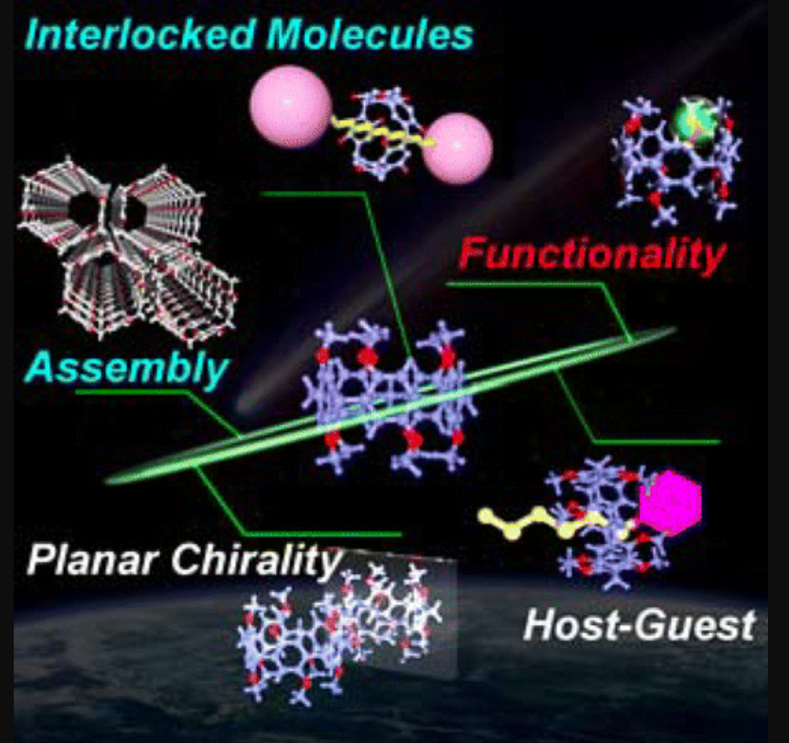
Pillar-Shaped Macrocyclic Hosts Pillar[n]arenes: New Key Players for Supramolecular Chemistry
Μεταπτυχιακό μάθημα: Υπερμοριακή Χημεία
Γιακουμάκης Νικόλαος ΑΜ:1054
Ημερομηνία: 27/04/2020

Slide 2
Outline
Introduction
Synthesis of Pillar[n]arenes
Functionalization of Pillar[n]arenes
Structure of Pillar[n]arenes
Host Property of Pillar[n]arenes
Supramolecular Assembly of Pillar[n]arenes
Mechanically Interlocked Molecules
Material Applications of Pillar[n]arenes
Conclusions

Slide 3
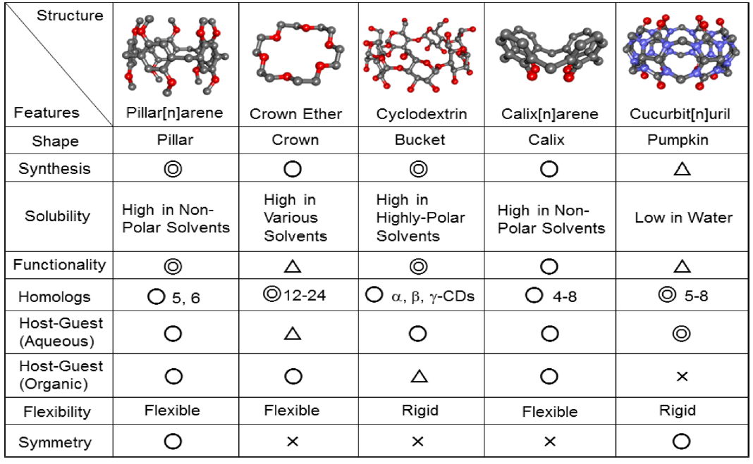
1. Introduction: Features of a host compound
Shape
Synthesis
Solubility
Functionality
Homologues
Host-guest ability
Figure 1. Comparison of pillar[n]arenes with several other well-known host molecules.

Slide 4
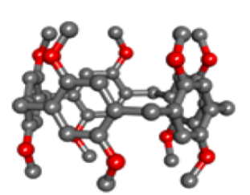
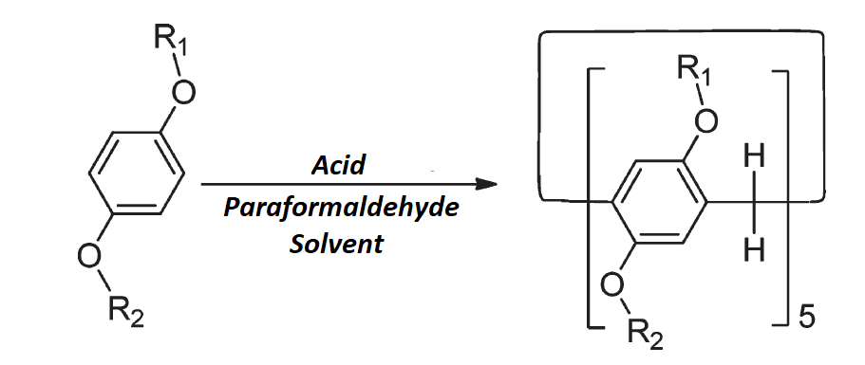
Pillar[n]arenes
2006-Pillar[n]arenes were discovered as a product of chance.
2008-The first pillar[5]arene synthesized by a standard method.
Pillar[n]arenes combine many of the interesting features of the typical macrocyclic compounds

Slide 5
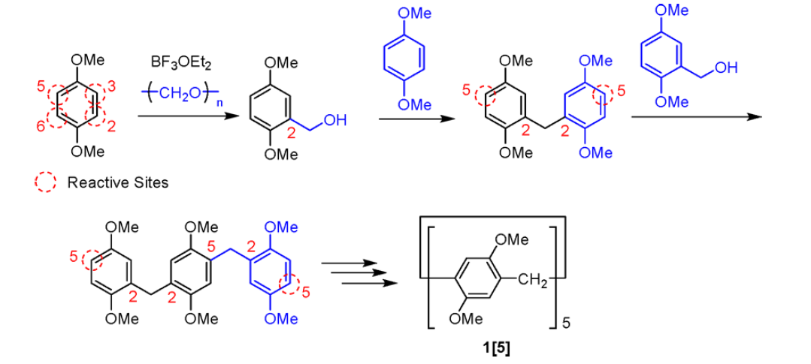
2. Synthesis
Challenges:
Control the reaction point of phenolic derivatives to inhibit the formation of three-dimensional network polymers
Inhibition of the linear polymer formation and acceleration of macrocyclization

Slide 6
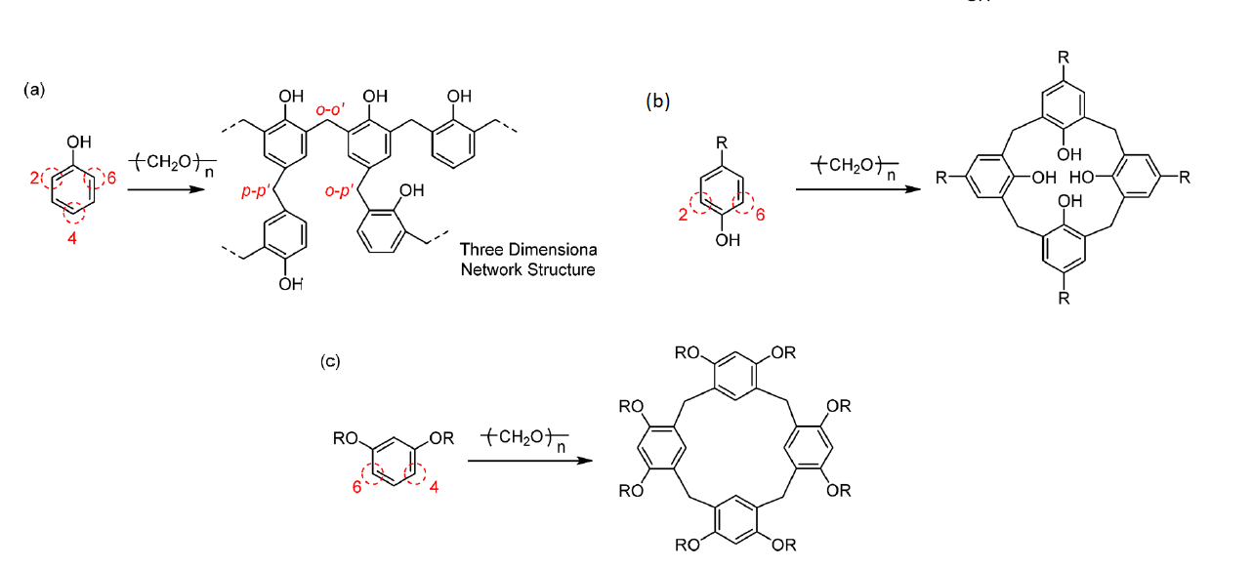
Synthesis: Controlling the Reaction Points of Phenolic Derivatives
Figure 2. (a) Phenolic Resins with Three-Dimensional Network Structure by Reaction of Phenol and Aldehydes; and Macrocyclization of (b) para-Substituted phenol, (c)Resorcinarene

Slide 7
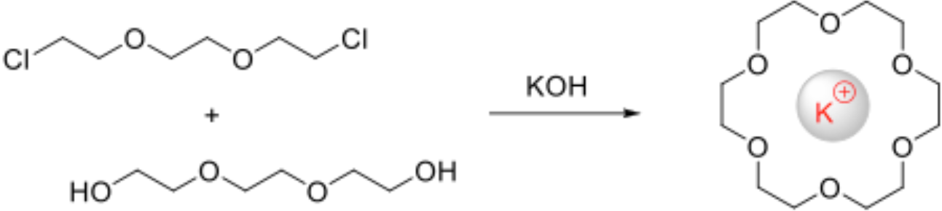
Template synthesis
Example: Crown ethers
Which moiety acts as template for high yield pillar[n]arenes synthesis ?

Slide 8
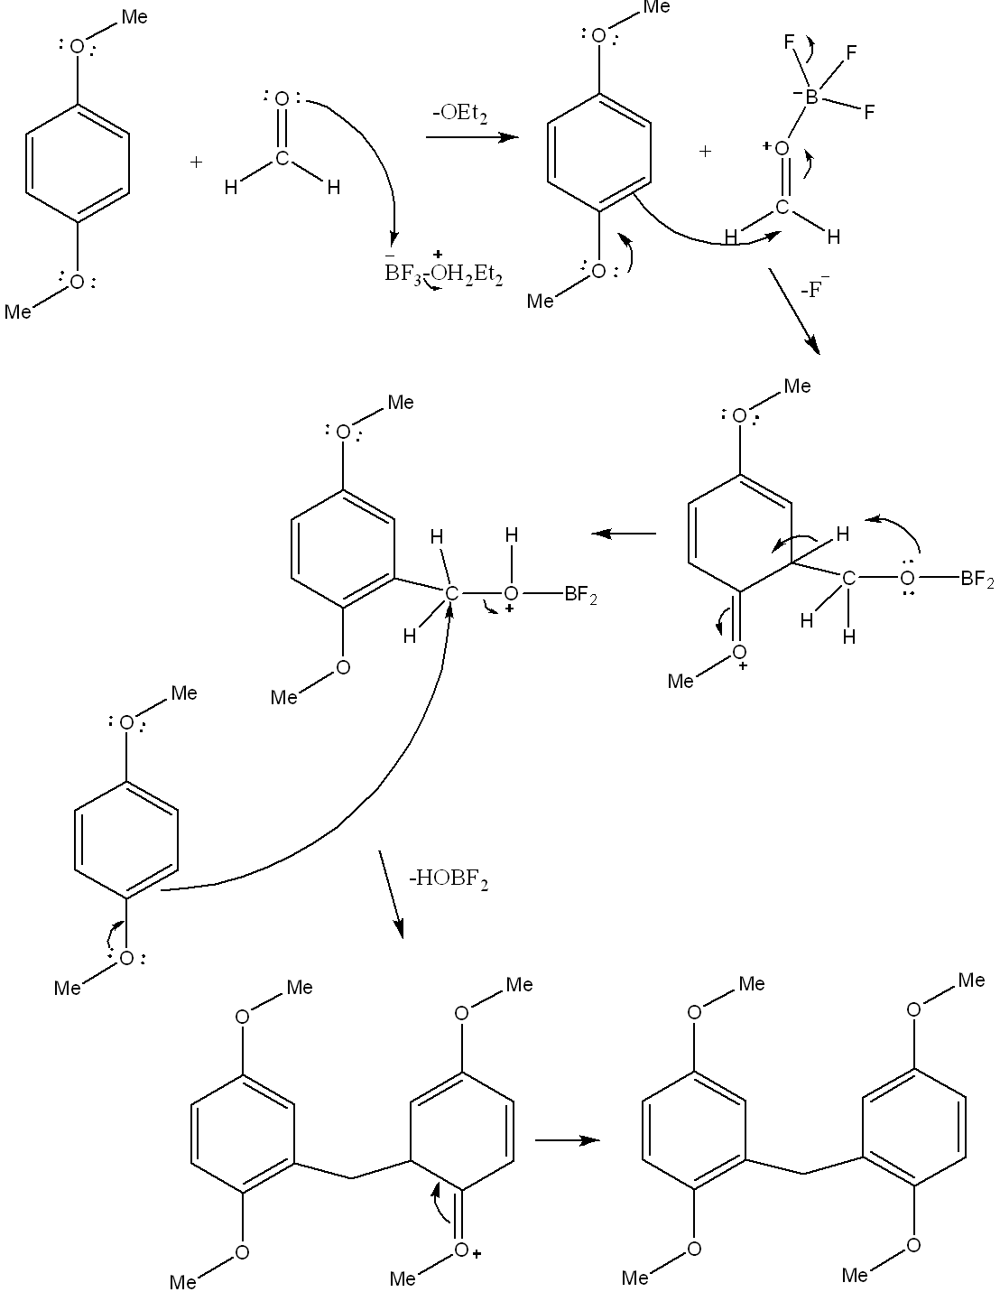
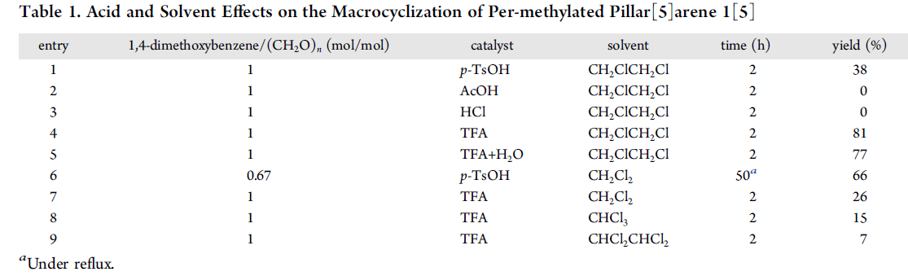
Effect of acid and solvent
BF₃OEt₂ vs FeCl₃ vs SnCl₂ vs AlCl₃
But strong Brønsted acids work too
What about the solvent ?

Slide 9
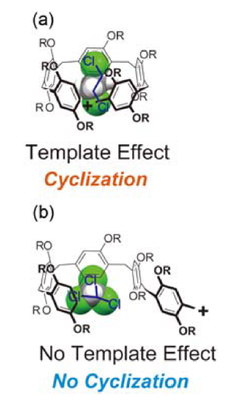
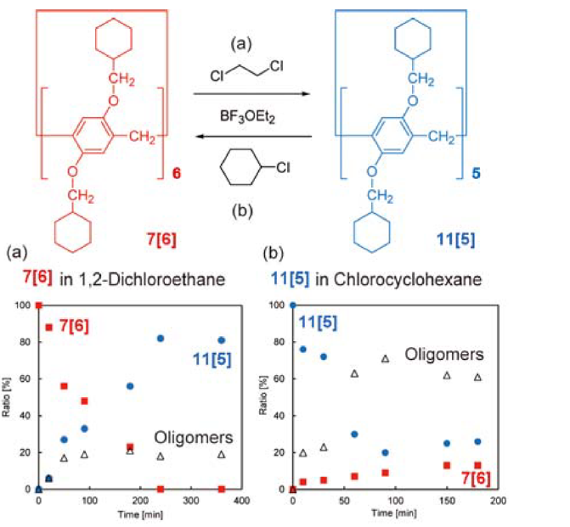
Template=Reaction’s solvent
Dynamic covalent bonds
Figure 3. (a) Linear 1,2-dichloroethane acts as a template for the formation of pillar[5]arenes, while (b) branched chloroform cannot act as a template for the synthesis of particular pillar[n]arene homologues.
Figure 4. Inversion between pillar[5]arene 11[5] and pillar[6]arene 7[6]. Ratios of 11[5] (blue ●) and 7[6] (red ■) and oligomers (△) by ring-opening reaction of (a) 7[6] in 1,2-dichloroethane and (b) 11[5] in chlorocyclohexane at 80 °C, which were monitored by NMRanalysis of the reaction mixtures over time.

Slide 10
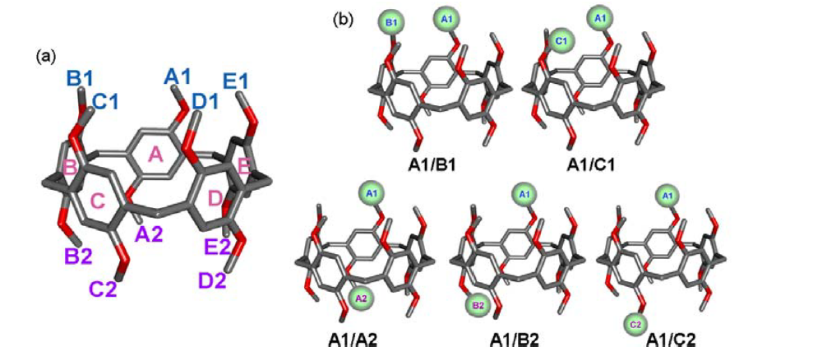
3. Functionalization of Pillar[n]arenes
Figure 5. (a) Assignment of positions in pillar[5]arenes. (b) Constitutional isomers of a difunctionalized pillar[5]arene. Stereoisomers generated by rotation of units are not included.
Two approaches have been devised for the synthesis of position selective-functionalizing pillar[n]arenes:
exchange of the substituents by deprotection followed by etherification of preformed pillar[n]arenes
cyclization of 1,4-dialkoxybenzene with another 1,4-dialkoxybenzene derivative with functional groups.

Slide 11
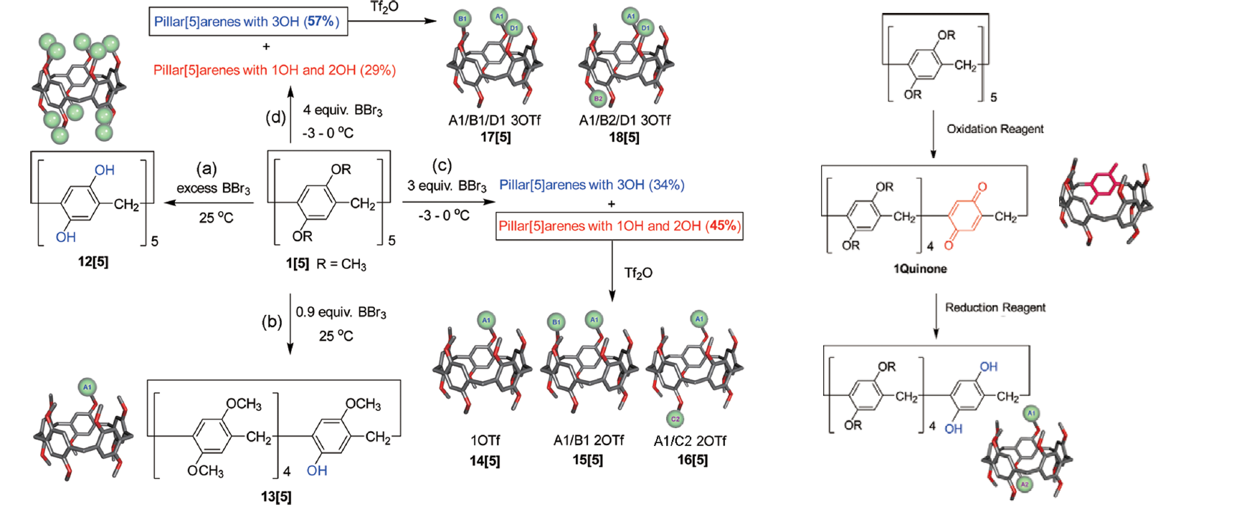
Functionalization of Pillar[n]arenes

Slide 12
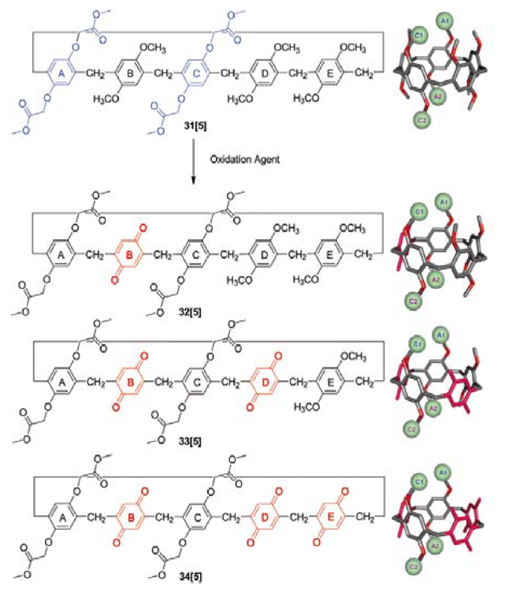
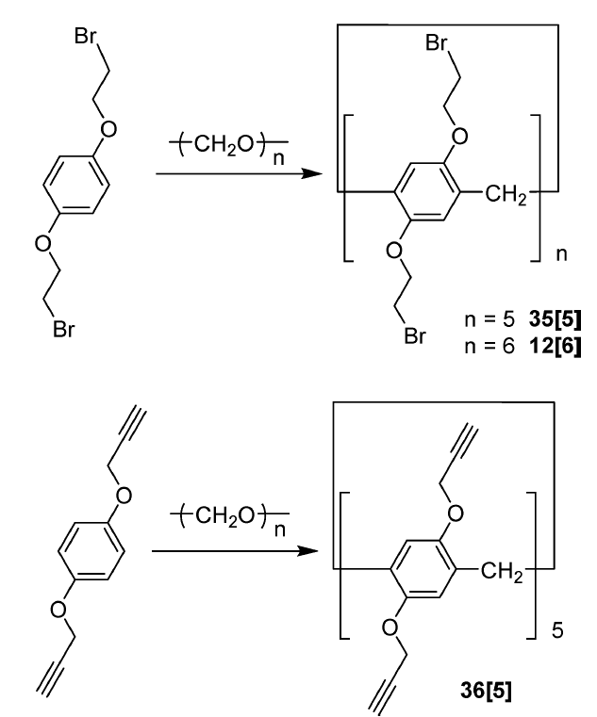
Functionalization of Pillar[n]arenes

Slide 13
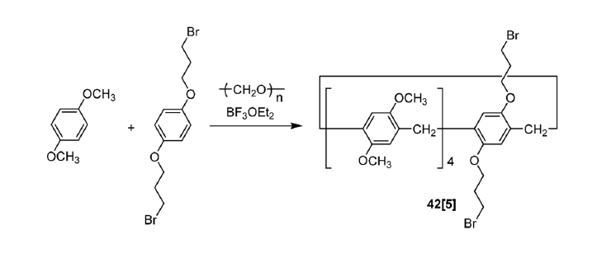
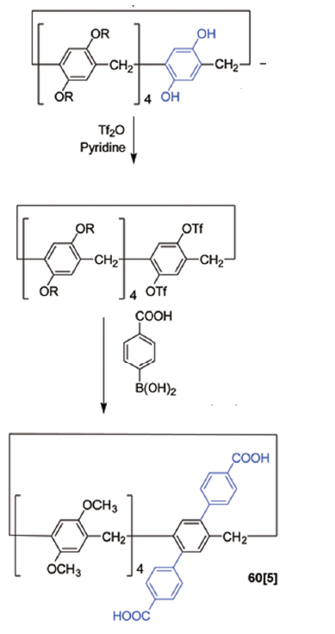
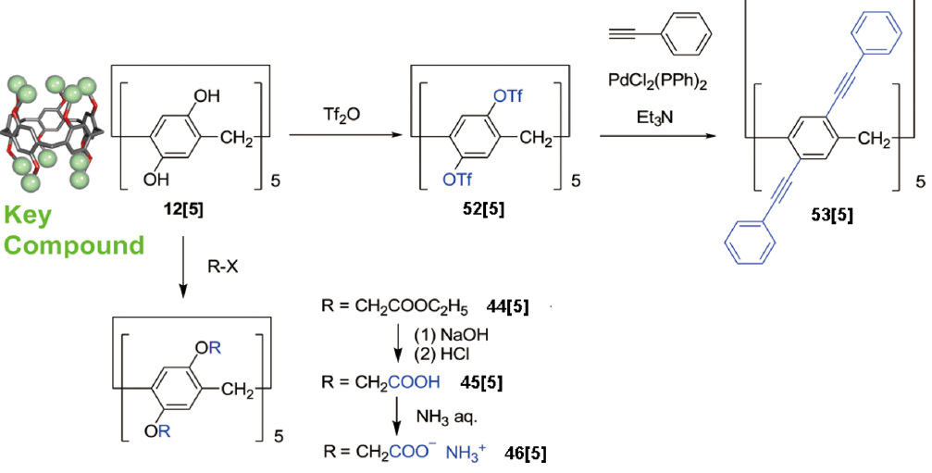
Functionalization of Pillar[n]arenes

Slide 14
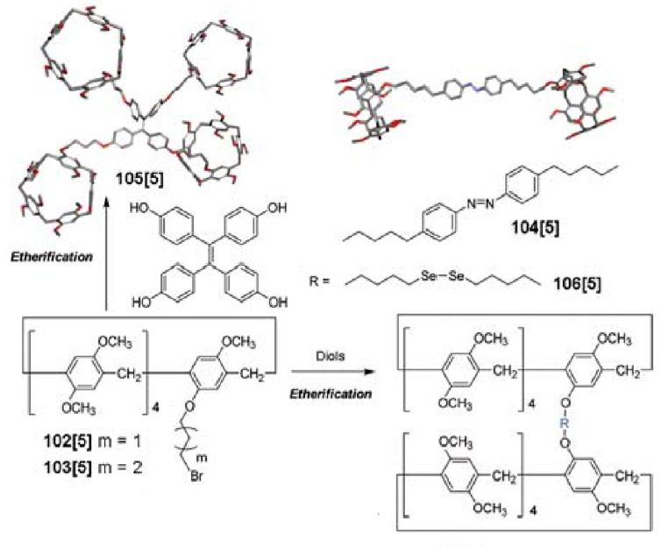
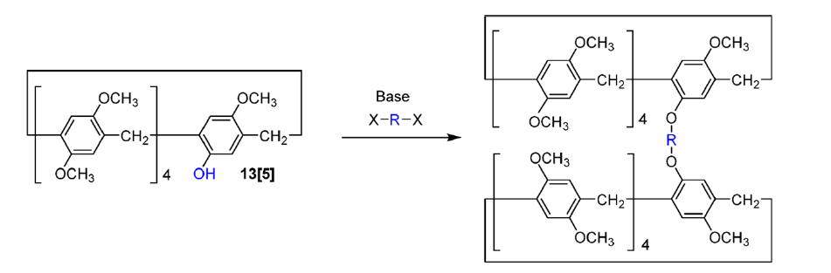
Functionalization of Pillar[n]arenes

Slide 15
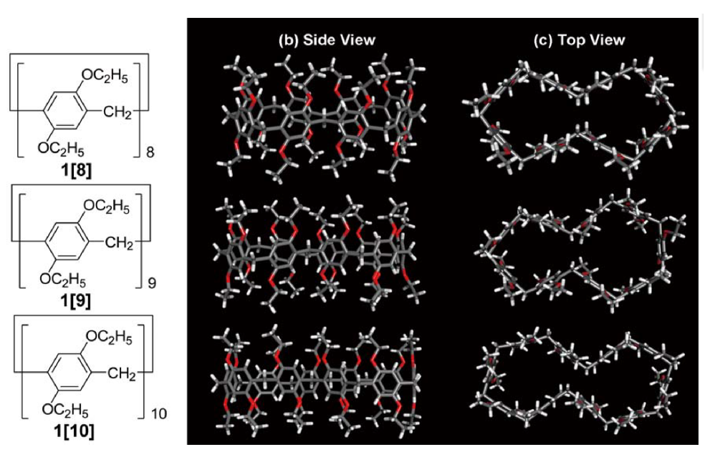
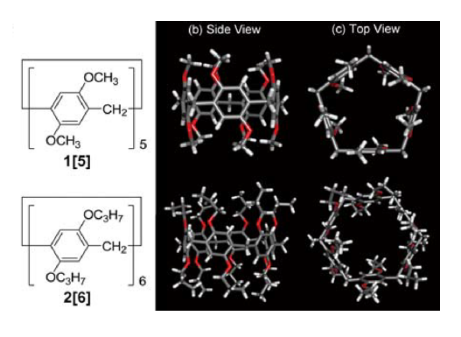
4. Structure of pillar[n]arenes

Slide 16
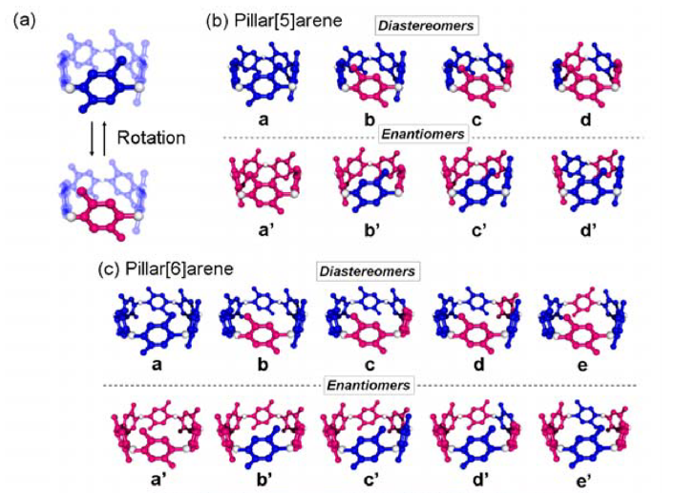
Isomers
Figure 6. (a) Rotational mode of the benzene units of pillar[n]arenes. Conformers of (b) pillar[5]arene and (c) pillar[6]arene caused by rotation of the benzene units.

Slide 17
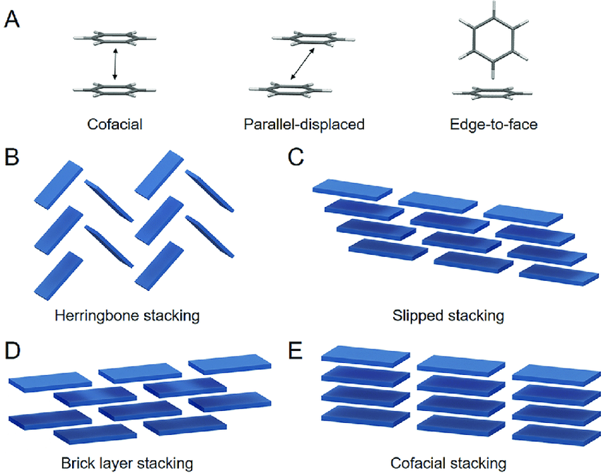
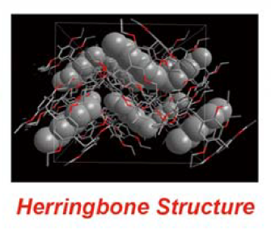
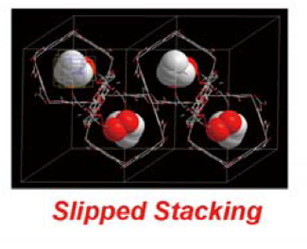
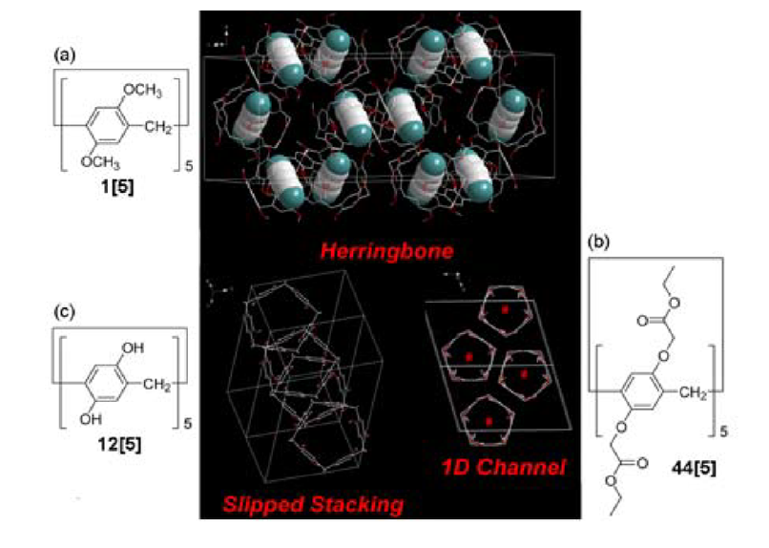
Assembled Structure of Pillar[n]arenes

Slide 18
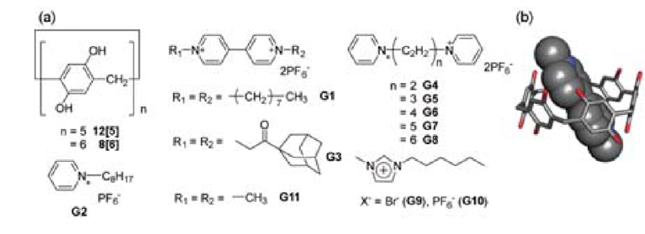
5. Host property of Pillar[n]arenes
1. Charge transfer interactions
Figure 7. (a) Chemical structures of the per-hydroxylated pillar[5] and pillar[6]arenes and the electron-accepting guest molecules. (b) Xray crystal structure of 8[6]⊃G11 CT complex.

Slide 19
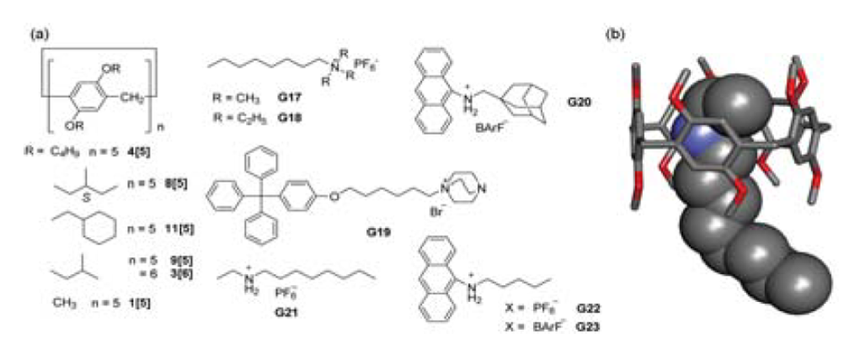
Host property of Pillar[n]arenes
2. Complexation by Cation/π interactions
Figure 8. (a) Chemical structures of the per-alkylated pillar[5]- and pillar[6]arenes and their cationic guest molecules. (b) X-ray crystal structure of the 1[5]⊃G21 complex.

Slide 20
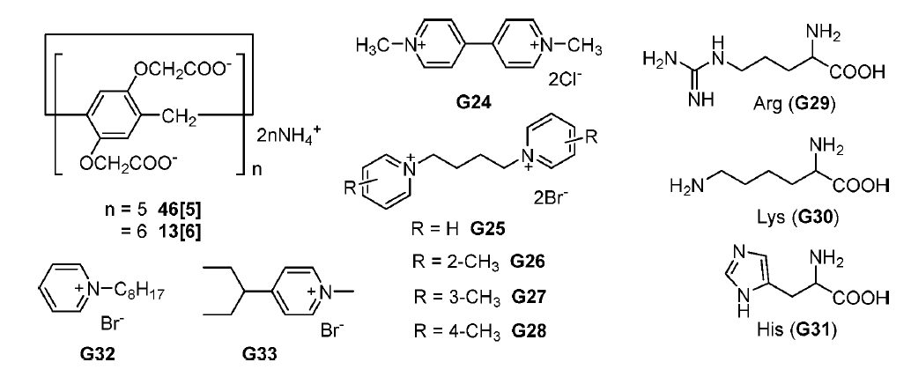
Host property of Pillar[n]arenes
3. Complexation by Hydrophobic/Hydrophilic interactions
Figure 9. Chemical structures of anionic water-soluble pillar[5]- and pillar[6]arenes and their guest molecules

Slide 21
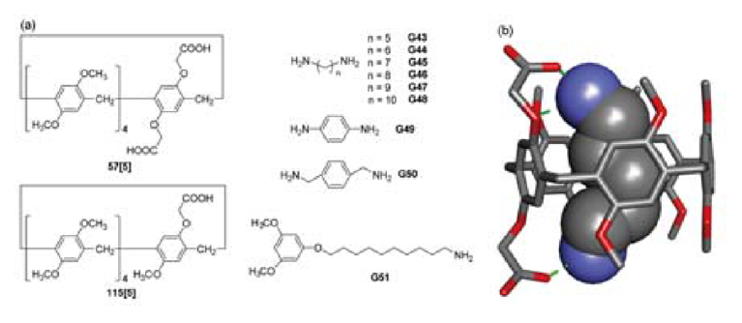
Host property of Pillar[n]arenes
4. Complexation by Cationic/Anionic interactions
Figure 10. (a) Chemical structures of pillar[5]arenes with carboxylic acid moieties and their amine guests. (b) X-ray crystal structure of the 57[5]⊃G43 complex.

Slide 22
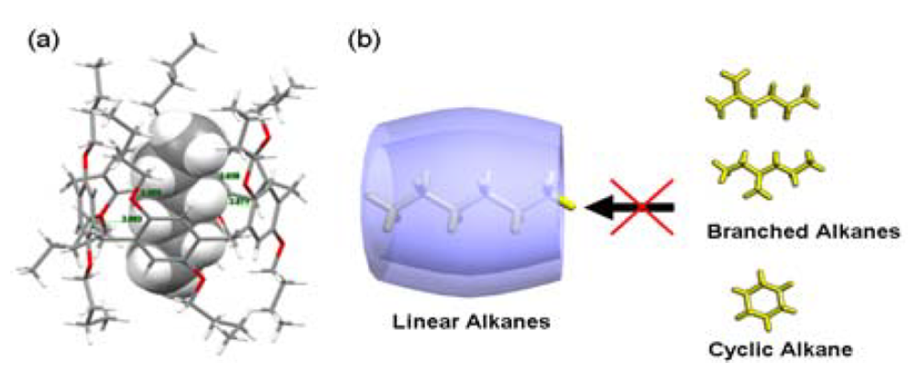
Host property of Pillar[n]arenes
5. Complexation by Hydrogen-Bond interactions
Figure 11. (a) X-ray crystal structure of the 4[5]⊃n-hexane complex. (b) Alkane shape-selective host−guest complexation process.

Slide 23
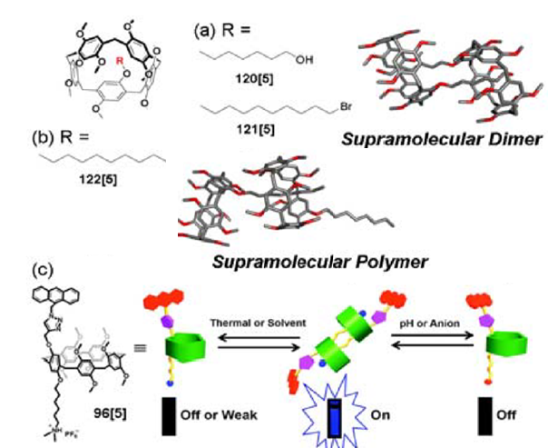
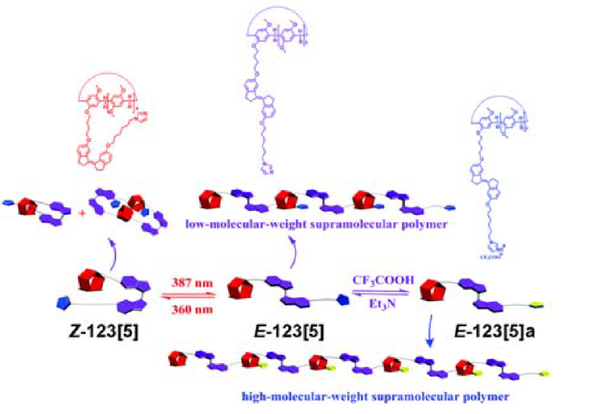
6. Supramolecular assembly of pillar[n]arenes
Utilization of the host properties that mentioned

Slide 24
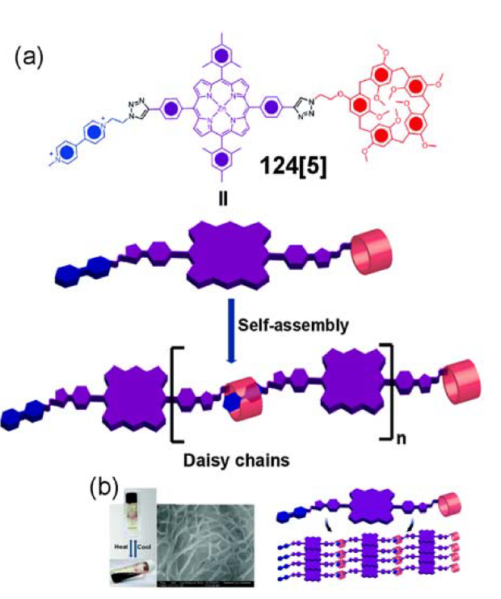
Supramolecular assembly of pillar[n]arenes
Charge transfer interaction
π-π interactions
Figure 12. (a) Self-assembly of the host−guest porphyrin conjugate 124[5]. (b) Image for the reversible formation of an organogel from 124[5] and SEM image of the gel formed from high concentrations of 124[5].

Slide 25
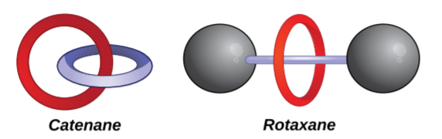
7. Mechanically interlocked molecules
Mechanical bond is an entanglement in space between two or more molecular entities (component parts) such that they cannot be separated without breaking or distorting chemical bonds between atoms. Mechanomolecule is a molecule possessing one or more mechanical bonds
Figure 13. Figure 1.1 Graphical representations of a catenane (left) and a rotaxane (right), which comprise the two main classes of mechanomolecules.

Slide 26
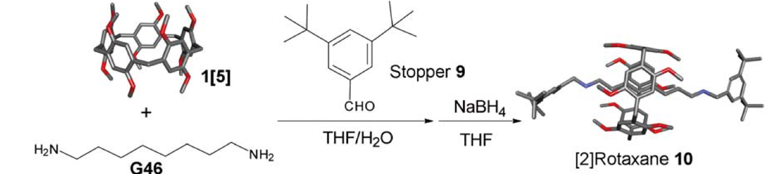
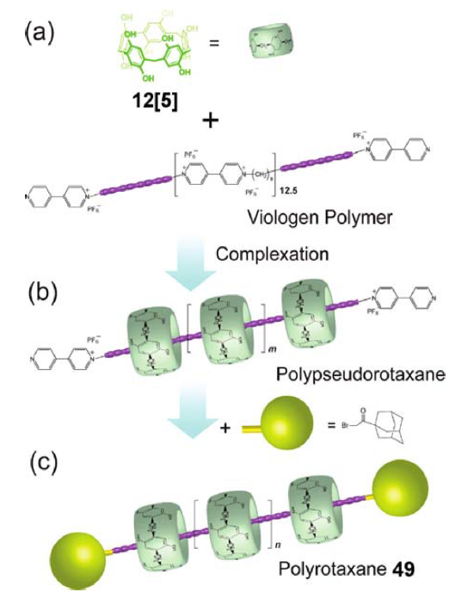
Rotaxanes
Figure 14. First pillar[5]arene-based [2]rotaxane 10 produced with end-capping by reaction between diamine axle G46 and an aldehyde stopper 9.
Figure 15. Preparation of pillar[5]arene-based polyrotaxanes using viologen polymeric chain.

Slide 27
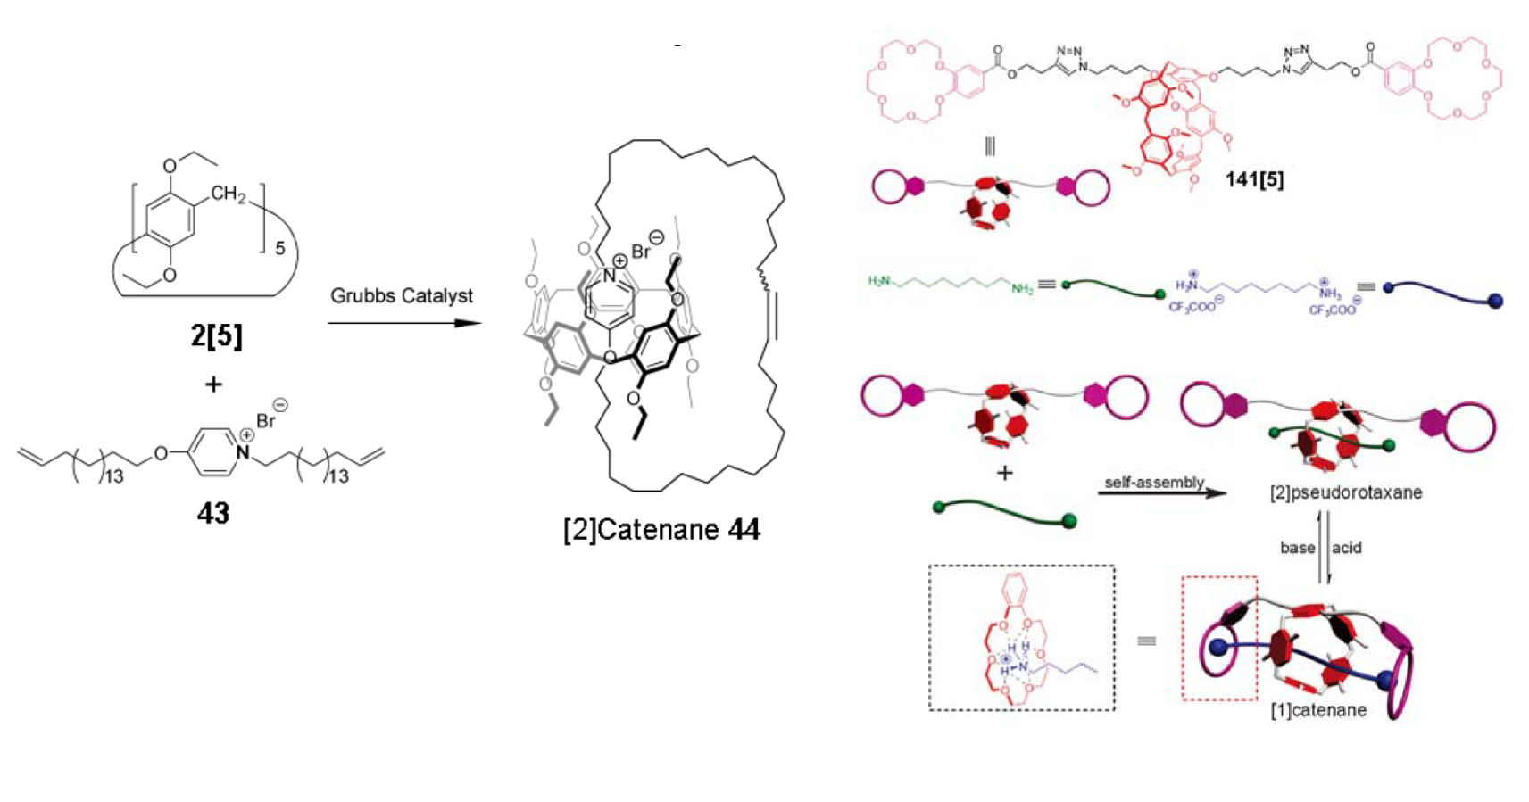
Catenanes
Figure 16.(a) The first pillar[n]arene-based catenane 44
Figure 17. Figure 71. (a) Representation of the pH-responsive dynamic catenane

Slide 28
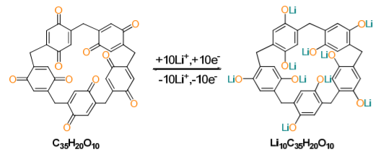
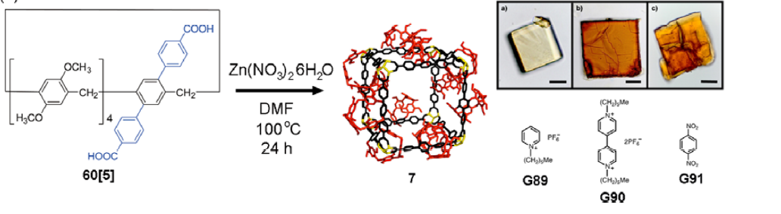
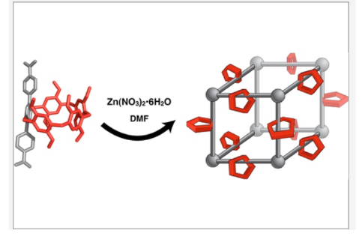
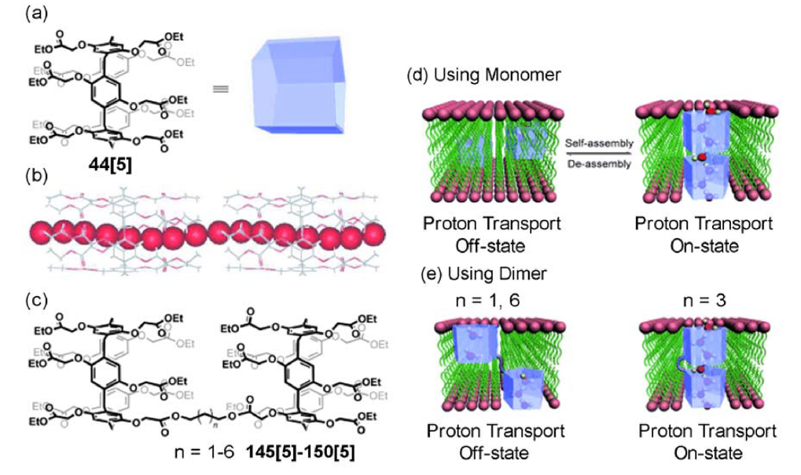
8. Applications of pillar[n]arenes
1. Electronic materials: organic cathods in lithium ion batteries
3.MOFs synthesis
2. Artificial Transmembrane Channels
4. Shape selective catalysis
5.Removal organic pollutants from water
6.Quencing the generation of ROS

Slide 29
9. Conclusions
Pillar[n]arenes were synthesized in 2008, thus this research field is very recent and quite attractive
These macrocyclic molecules show excellent host-guest properties
The presence of the methoxy-groups allows further functionalization
Pillar[n]arenes assemble into unique supramolecular stractures which have great potential for use at several important applications

Slide 30
Thank you for your attention!

Slide 31
References
Angew. Chem. Int. Ed. 2017, 56, 2–34
RSC Adv., 2014, 4, 31239–31248
Chem. Rev. 2016, 116, 7937−8002
Accounts of chemical research,45,8,1294–1308
An Introduction to the Mechanical Bond. (2016). The Nature of the Mechanical Bond, 1–54, Carson J. Bruns, J. Fraser Stoddart

